Slide 1
WEB TECHNOLOGY LAB

Slide 2
HYPERTEXT MARKUP LANGUAGE
(HTML) is the standard markup language for documents designed to be displayed in a web browser.
It is the code that is used to structure a web page and its content.
<!DOCTYPE html>
<html>
<head>
<title>HTML Tutorial</title>
</head>
<body>
<h2>Welcome To GFG</h2>
<p>Hello World! I Don't Give a Bug </p>
</body>
</html>

Slide 3
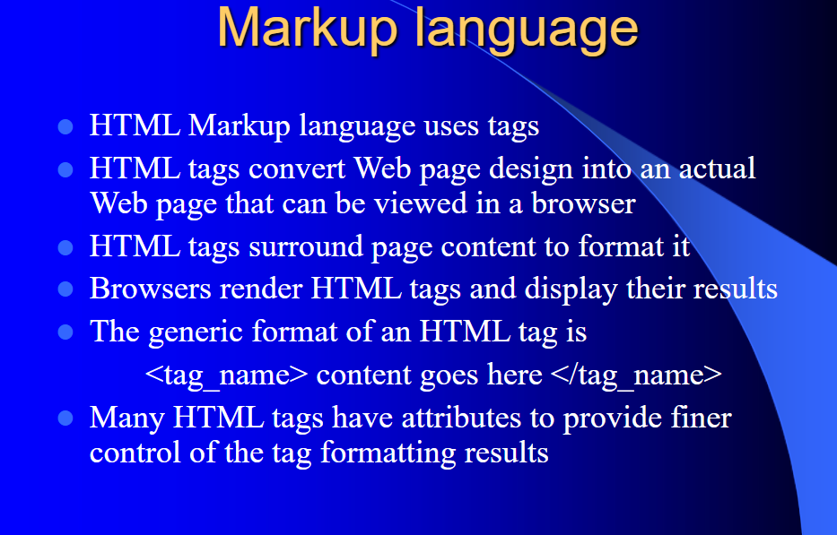

Slide 4
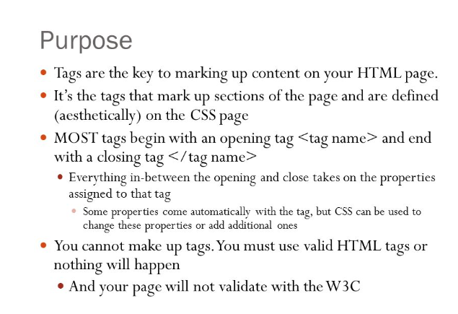

Slide 5
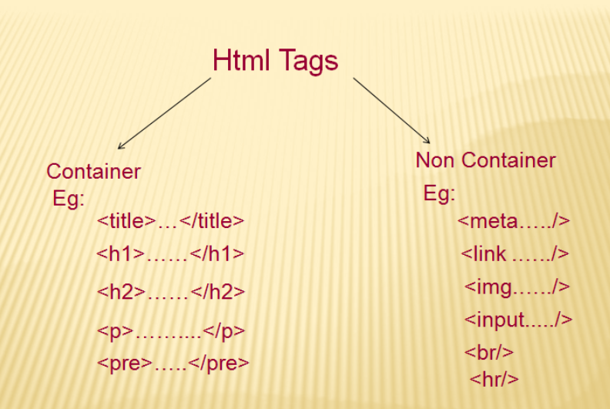

Slide 6
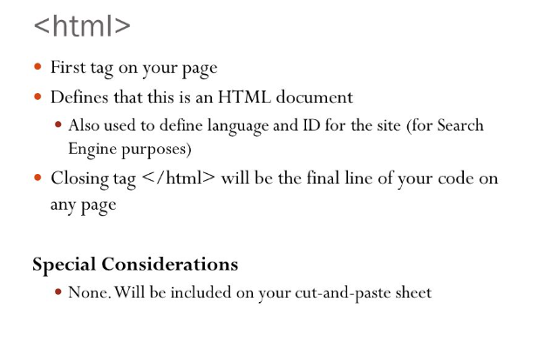

Slide 7
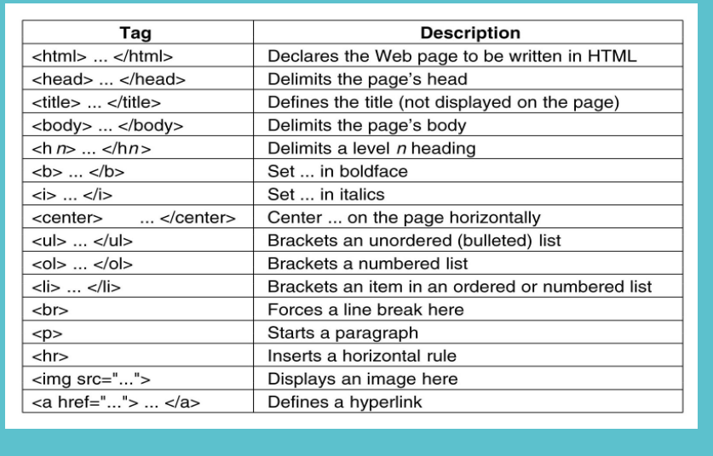

Slide 8
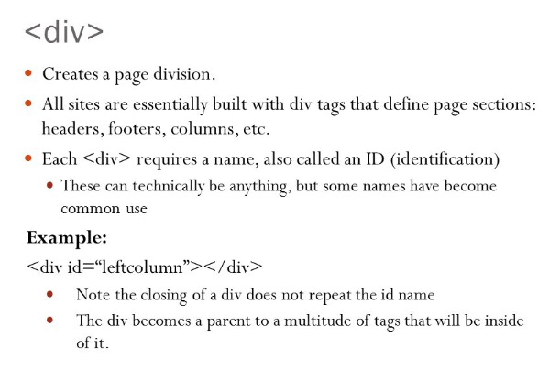

Slide 9
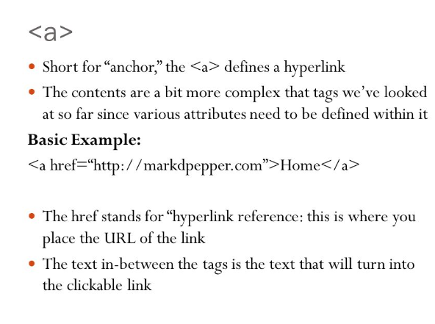

Slide 10
FORM
The <form> element is a container for different types of input elements, such as: text fields, checkboxes, radio buttons, submit buttons, etc.
Form syntax:
<form action=“url.html” method=“post/get”>
:
:</form>

Slide 11
<html>
<head>
<title></title>
</head>
<body>
<form>
<input type="text" id="fname" name="fname">First name<br> <input type="text" id="lname" name="lname"> Last name
</form>
</body>
</html>

Slide 12
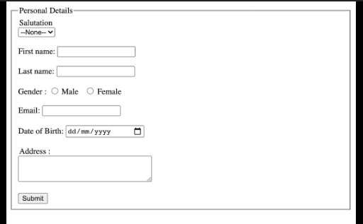
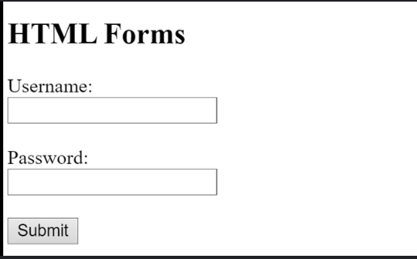
Example of Form

Slide 13
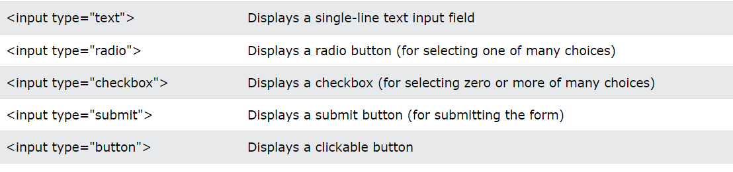
The <textarea> tag defines a multi-line text input control.
<textarea id="" name="" rows="4" cols="50"> At w3schools.com you will learn how to make a website. They offer free tutorials in all web development technologies. </textarea>
RESET :<input type="reset" value="Reset">reset

Slide 14
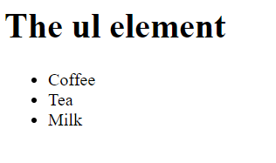
ul and li
The <ul> tag defines an unordered (bulleted) list.
The <li> tag defines a list item.
<!DOCTYPE html>
<html>
<body>
<h1>The ul element</h1>
<ul>
<li>Coffee</li>
<li>Tea</li>
<li>Milk</li>
</ul>
</body>
</html>

Slide 15
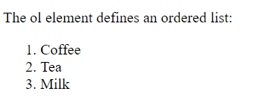
ol
In <ol>, the list items will usually be displayed with numbers or letters.
<!DOCTYPE html>
<html>
<body>
<h1>The ol and ul elements</h1>
<p>The ol element defines an ordered list:</p>
<ol>
<li>Coffee</li>
<li>Tea</li>
<li>Milk</li>
</ol>
</body>
</html>

Slide 16
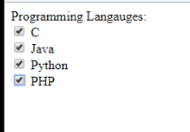
.
CHECK BOX
The <input type="checkbox"> defines a checkbox.
The checkbox is shown as a square box that is ticked (checked) when activated
<html>
<head>
<title></title>
</head>
<body>
<form>
<h1>Vehicle</h1>
<input type="checkbox" name="vehicle1" value="Bike"> I have a bike
<br>
<input type="checkbox" name="vehicle2" value="Car">car
</form>
</body>
</html>

Slide 17
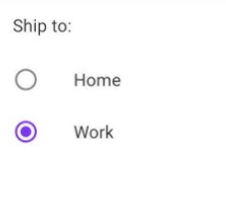
Radio Button
Only one radio button in a group can be selected at the same time.
<html>
<head>
<title></title>
</head>
<body>
<form>
<h1>Gender</h1>
<input type="radio" name="gender" value="male">male
<br>
<input type="radio" name="gender" value="female">female
</form>
</body>
</html>

Slide 18
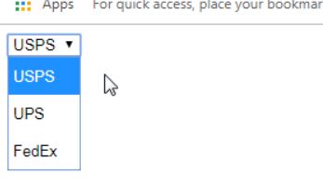
Drop-down List
<html>
<head>
<title></title>
</head>
<body>
<form>
<h1>Cars</h1>
<select name="cars" id="cars">
<option>Choose a car</option>
<option value="volvo">Volvo</option>
<option value="saab">Saab</option>
<option value="mercedes">Mercedes</option>
<option value="audi">Audi</option>
</select>
</form>
</body>
</html>

Slide 19
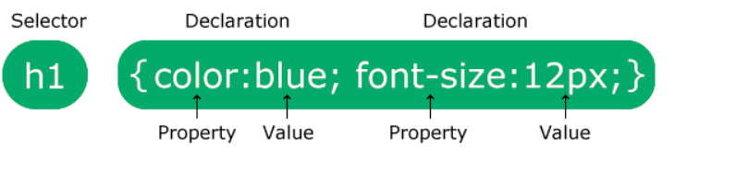
What is CSS?
CSS stands for Cascading Style Sheets
CSS describes how HTML elements are to be displayed on screen, paper, or in other media
CSS Syntax:
The selector points to the HTML element you want to style.
Eg: p { color: red; text-align: center; }
p is a selector in CSS (it points to the HTML element you want to style: <p>).
color is a property, and red is the property value
text-align is a property, and center is the property value

Slide 20
Common CSS Properties
Color: color: red;
Background Color: background-color: yellow;
Font Size: font-size: 16px;
Text Alignment: text-align: center;
Margin: margin: 10px;
Padding: padding: 5px;
Border: border: 1px solid black;

Slide 21
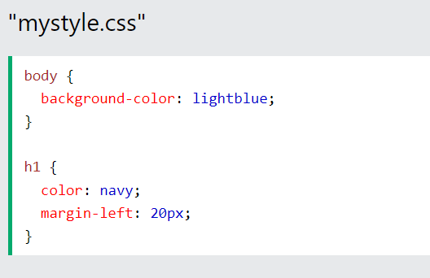
There are three ways of inserting a style sheet:
External CSS
Internal CSS
Inline CSS
External CSS
<!DOCTYPE html>
<html>
<head>
<link rel="stylesheet" href="mystyle.css">
</head>
<body>
<h1>This is a heading</h1>
<p>This is a paragraph.</p>
</body>
</html>

Slide 22
Internal CSS
Internal styles are defined within the <style> element, inside the <head> section of an HTML page:
<!DOCTYPE html> <html> <head> <style> body { background-color: linen; } h1 { color: maroon; margin-left: 40px; } </style> </head>

Slide 23
Inline CSS
Inline styles are defined within the "style" attribute of the relevant element:
<!DOCTYPE html> <html> <body> <h1 style="color:blue;text-align:center;">This is a heading</h1> <p style="color:red;">This is a paragraph.</p> </body> </html>

Slide 24
CSS Colors
Colors are specified using predefined color names, or RGB, HEX, HSL, RGBA, HSLA values
<!DOCTYPE html>
<html>
<body>
<p>Same as color name "Tomato":</p>
<h1 style="background-color:rgb(255, 99, 71);">rgb(255, 99, 71)</h1>
<h1 style="background-color:#ff6347;">#ff6347</h1>
<h1 style="background-color:hsl(9, 100%, 64%);">hsl(9, 100%, 64%)</h1>
<p>Same as color name "Tomato", but 50% transparent:</p>
<h1 style="background-color:rgba(255, 99, 71, 0.5);">rgba(255, 99, 71, 0.5)</h1>
<h1 style="background-color:hsla(9, 100%, 64%, 0.5);">hsla(9, 100%, 64%, 0.5)</h1>
<p>In addition to the predefined color names, colors can be specified using RGB, HEX, HSL, or even transparent colors using RGBA or HSLA color values.</p>
</body>
</html>

Slide 25
HEX (Hexadecimal Color Codes)
The HEX code represents colors as a six-digit combination of three pairs of characters (one for red, one for green, and one for blue).
Example:
#FFFFFF = white (R: 255, G: 255, B: 255)
#000000 = black (R: 0, G: 0, B: 0)
#FF5733 = orange shade (R: 255, G: 87, B: 51)
RGB (Red, Green, Blue)
RGB is based on how much of red, green, and blue light is mixed to generate a particular color.
A higher number means more of that color.
Example:
rgb(255, 255, 255) = white
rgb(0, 0, 0) = black
rgb(255, 87, 51) = orange shade
HSL (Hue, Saturation, Lightness)
Unlike RGB, which deals with the amount of red, green, and blue light, HSL deals with:
Hue: the actual color.
Saturation: the intensity of the color.
Lightness: how light or dark the color is.
Example:
hsl(0, 100%, 50%) = pure red.
hsl(120, 100%, 50%) = pure green.
hsl(240, 100%, 50%) = pure blue.

Slide 26
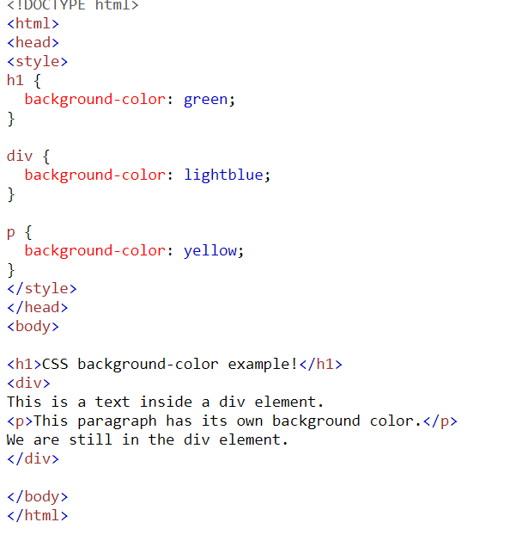
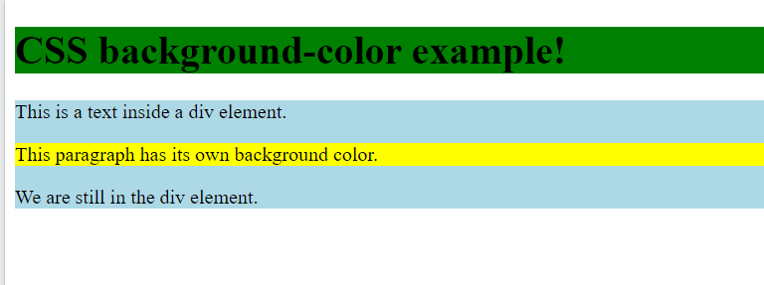
Background-color

Slide 27
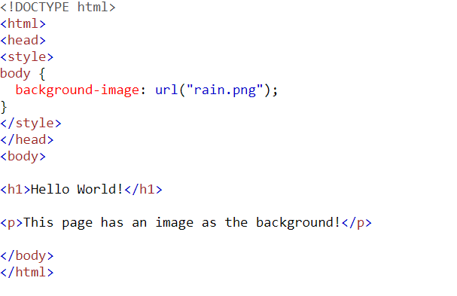

CSS background-image

Slide 28
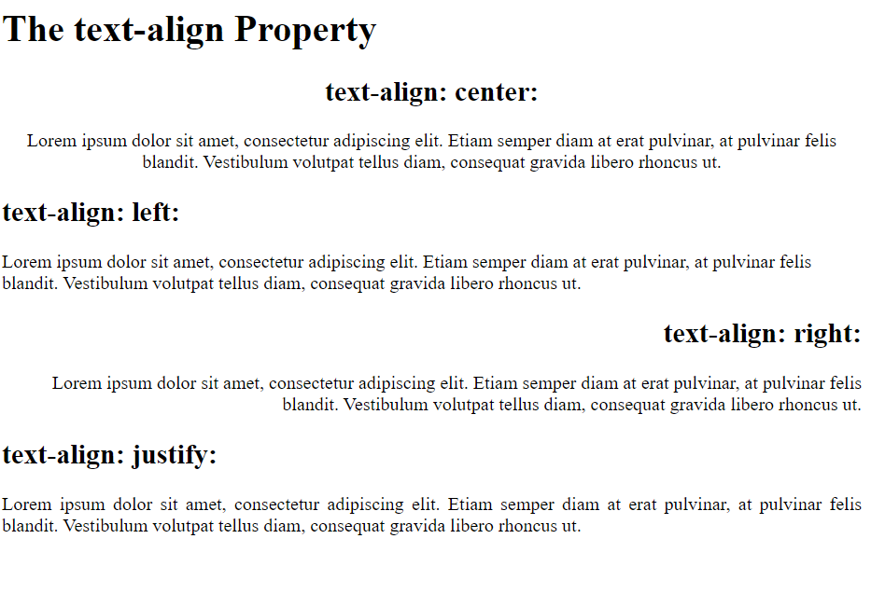
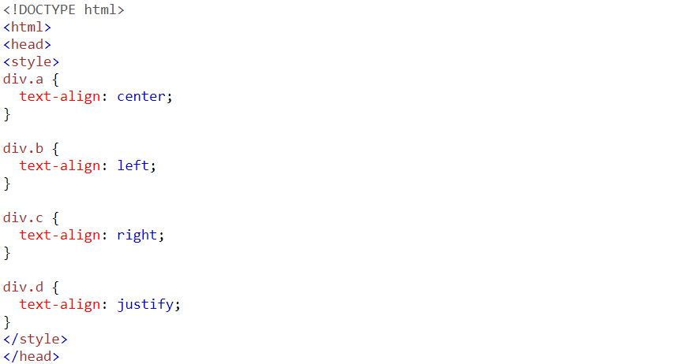
Text Alignment in CSS
text-align: Aligns inline content like text within a block-level element.
left: Aligns the text to the left.
right: Aligns the text to the right.
center: Centers the text horizontally.
justify: Stretches the text to fill the width of the container, aligning both left and right edges.

Slide 29
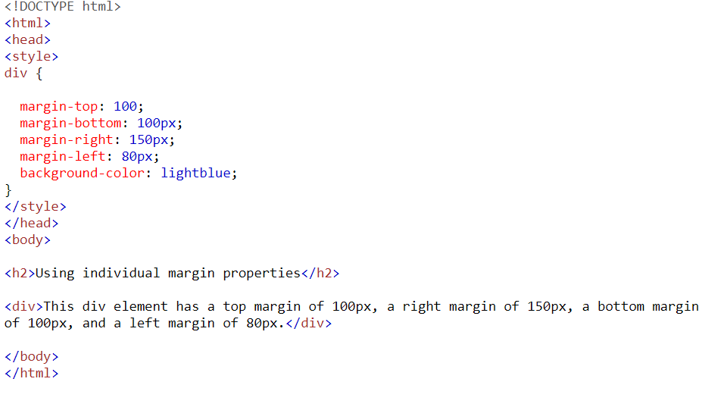
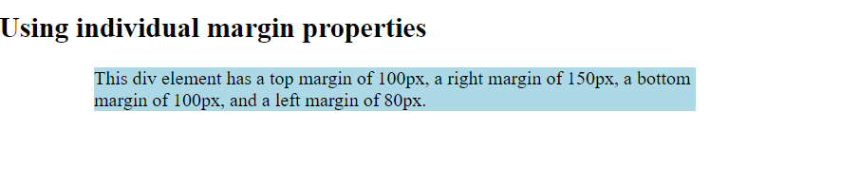
CSS Margins
The CSS margin properties are used to create space around elements, outside of any defined borders.
CSS has properties for specifying the margin for each side of an element:
margin-top
margin-right
margin-bottom
margin-left

Slide 30
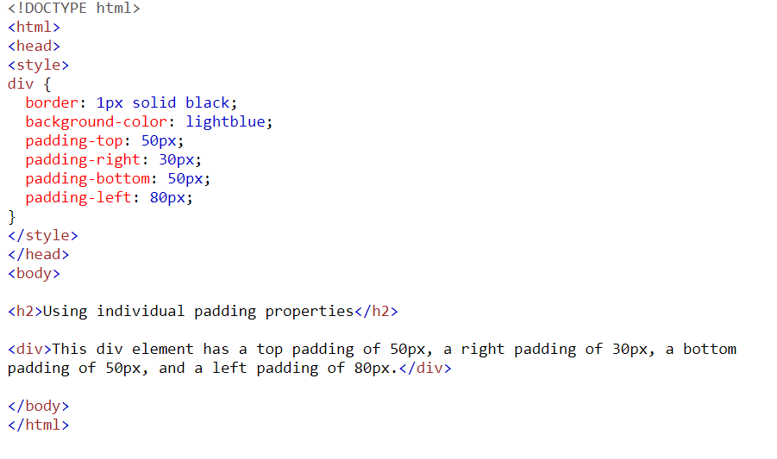
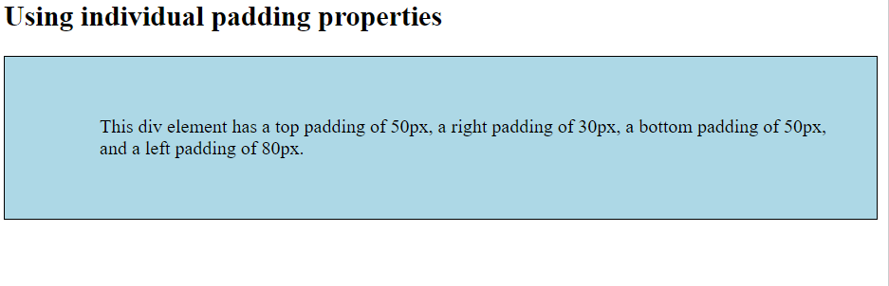
CSS Padding
The CSS padding properties are used to generate space around an element's content, inside of any defined borders.
CSS has properties for specifying the padding for each side of an element:
padding-top
padding-right
padding-bottom
padding-left

Slide 31
CSS Border Style
The border-style property specifies what kind of border to display.
The following values are allowed:
dotted - Defines a dotted border
dashed - Defines a dashed border
solid - Defines a solid border
double - Defines a double border
groove - Defines a 3D grooved border. The effect depends on the border-color value
ridge - Defines a 3D ridged border. The effect depends on the border-color value
inset - Defines a 3D inset border. The effect depends on the border-color value
outset - Defines a 3D outset border. The effect depends on the border-color value
none - Defines no border
hidden - Defines a hidden border

Slide 32
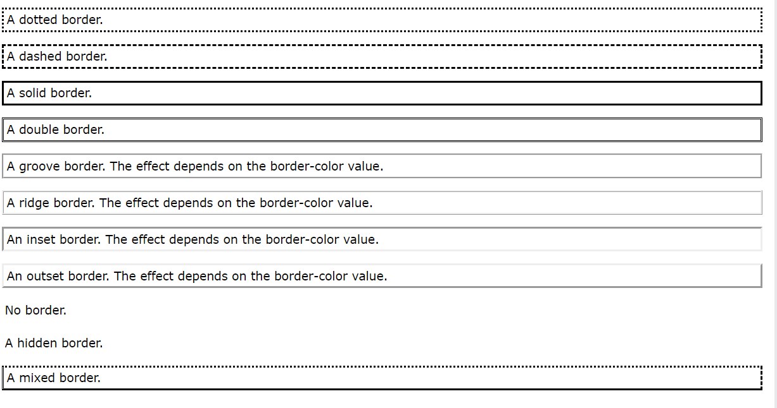

Slide 33
CSS Height, Width and Max-width
The CSS height and width properties are used to set the height and width of an element.
The CSS max-width property is used to set the maximum width of an element.
CSS height and width Values
The height and width properties may have the following values:
auto - This is default. The browser calculates the height and width
length - Defines the height/width in px, cm, etc.
% - Defines the height/width in percent of the containing block
initial - Sets the height/width to its default value
inherit - The height/width will be inherited from its parent value

Slide 34
